Slide 1


Cache Algorithm
Haijian Sun
sunh@uww.edu

Slide 2
Learning Object
Cache Algorithm
Least-Recently Used (LRU)
Cache Friendly Code

Slide 3
Cache Replacement Policy
Cache block’s Replacement Policy
Cache miss
Cache hit
When cache is full, and new block input in cache
Discards the previous blocks in cache
Least-Recently Used (LRU)
Discards the least recently used items first

Slide 4
Example of LRU
Let your cache can contain maximum 3 blocks
And your program need the blocks order
(7, 0, 1, 2, 0, 3, 0, 4, 2, 3, 0, 3, 2, 1, 2)
Program Need | 7
C.M. | 7
Program Need | 0
 | 7
C.M. | 0
Program Need | 1
 | 7
 | 0
C.M. | 1
Flow
Flow
Program Need | 2
C.M. | 2
 | 0
 | 1
Program Need | 0
 | 2
C.H. | 0
 | 1
Program Need | 3
 | 2
 | 0
C.M. | 3
Flow
Flow
Flow
Flow
Notes:
blocks/ not address

Slide 5
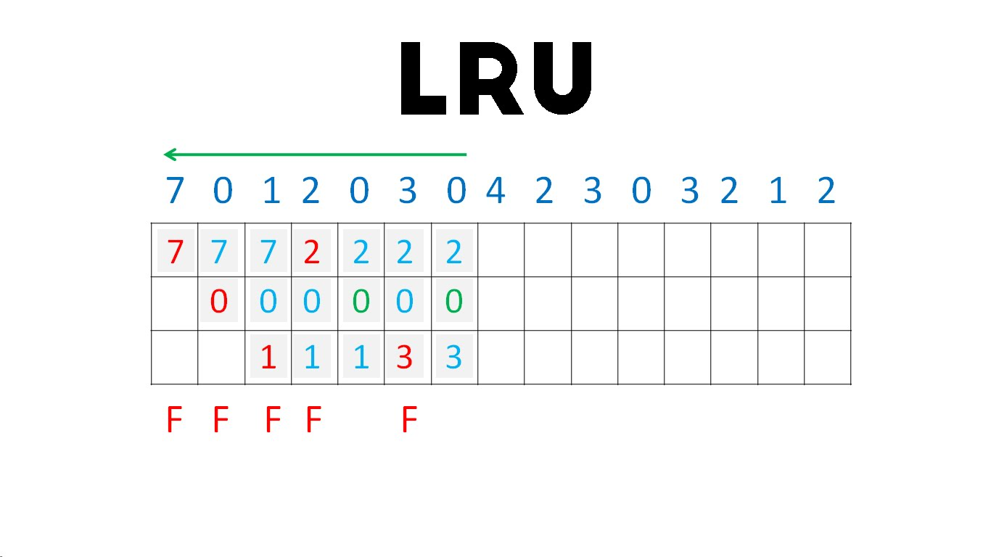
Example of LRU (cont.)
Try fill out the cache
How many times cache hit?
CM
CM
CM
CM
CH
CM
CH

Slide 6
Why need to know about Cache
We learned the Cache Algorithm. Why?
To make Cache Friendly Code
Be a powerful developer
What if user have limited cache?
Embedded system like Arduino
What if your software is required high speed?
Stock trading system
If you understand the computer organization, you will be a more powerful developer.

Slide 7
Cache Friendly Code
Increasing data locality on memory
The goal is to place related data close in memory to allow efficient caching
Increasing Temporal locality
The used data will be reused, so, move/stay at higher level
Increasing Spatial Locality
The data/address close to the used data may be used, so move at a higher level
0032
0032
a [1]
0028
0028
0024
0024
0020
0020
if one block can contain 3 addresses
a [2]
0016
a [2]
0016
a [1]
0012
0012
a [0]
0008
a [0]
0008
Notes:
Aforetime/ beforehand

Slide 8
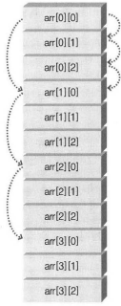
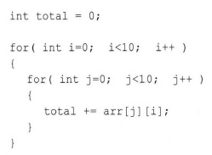
How to make Cache Friendly Code
Make a sequence access
Try to access the last index first
Reduce cache block placement
i= 0
j= 0
i= 1
i= 2
L1 cache
j= 1
arr[0][0]
arr[0][1]
arr[0][2]
j= 2
9 cache miss between register and L1
arr[0][0]
arr[1][0]
arr[0][1]
arr[1][1]
arr[0][2]
arr[1][2]
L2 cache
Notes:
Let there are 10X10 array with values, and try to get total value of it.
Let the block only has 3 addresses.

Slide 9

Let’s make Cache Friendly code
Cache Friendly Code
Make cache friendly code

Slide 10
How to make Cache Friendly Code
Make a sequence access
Try to access the last index first
Reduce cache block placement
i= 0
j= 0
i= 1
i= 2
L1 cache
j= 1
arr[0][0]
arr[0][1]
arr[0][2]
i
j
j= 2
only 4 cache miss between register and L1
arr[0][0]
arr[1][0]
arr[0][1]
arr[1][1]
arr[0][2]
arr[1][2]
L2 cache
Notes:
Let there are 10X10 array with values, and try to get total value of it.
Let the block only has 3 addresses.

Slide 11
Summary
Cache
Cache Algorithm
Least-Recently Used (LRU)
Discards the least recently used items first
Cache friendly code
Increase Locality
Spatial Locality
Temporal Locality
Hard Disk
Register
L1 Cache
L2 Cache
Main Memory

